Slide 1
CMPE341 Project: Movie/Series Database
Ahmet Berkay GİDİRİŞLİOĞLU
Ezgi ÇAVAŞ
Yiğit Fatih KILIÇ
Mert BULUT

Slide 2
INTRODUCTION
Company Information
  The company we work on is Noktacom Media Internet Services.
  They have a few sites. One that we will work on Sinemalar.com that shares information about movies. Sinemalar.com is one of the biggest websites about movies in Turkey.

Slide 3
Aim of the Project
Our employer (Noktacom Media Internet Services) has a database that shows information about movies and series to the end users. But this current database’s design and architecture is old and inefficient.
So our aim is to re-design this database and make it more faster.

Slide 4
General Design
Our database will held the information about
  Movies and Television Series
  The Crew who worked on these projects, such as writers, directors, musicians, etc.
  The users’ reviews, ratings.
  And genre of the movies and the TV series.

Slide 5
Entities’ Attributes & Relationships
Movie is our first entity.
  Movie ID is the primary key.
  Year of the movie released.
  Budget of the movie.
  Runtime of the movie.
  Box-office of the movie.
  Rating of the movie from reviewers.
  Country of the movie.
  Language of the movie.
  The title of the movie.

Slide 6
Entities’ Attributes & Relationships
Second entity is TVSeries.
  Series ID is primary key.
  Start-date of the series.
  End-date of the series, if the series is finished.
  Budget of the series.
  Season Number of the series.
  Title of the series.
  Rating of the series.
  Language of the series.
  Country of the series.
  Platform of the series.

Slide 7
Entities’ Attributes & Relationships
Review is our third entity.
  Review ID is the primary key.
  The post date of the review.
  Nickname of the user.
  Rating from a user.
  Review text to show the comment

Slide 8
Entities’ Attributes & Relationships
Crew is our fourth entity and it is a superclass. It includes information about crew members.
  Crew ID is the primary key.
  Name of a crew member.
  Birthdate of a crew member.
  Nationality of a crew member.
  Brief biography of a crew member.

Slide 9
Entities’ Attributes & Relationships
Crew has subclasses:
  Writer has a type attribute to show what type of writer.
  Cast has
    Gender
    Awards
    Pre-job to show the previous works of the person.
  Director has a type attribute to show the type of the director.
  Musician has a song attribute to show the composed songs.
  Producer has a company attribute to show which movie company he/she is working with.

Slide 10
Entities’ Attributes & Relationships
Genre is an entity with only «Name» attribute for the genre which is also the primary key.

Slide 11
Entities’ Attributes & Relationships
Episode is a weak entity.
  Episode Number is the primary key.
  Season number.
  Name of the episode.

Slide 12
Entities’ Attributes & Relationships
Relationship of «TVSERIES»:
  «Includes»: shows series’ episodes’ information.
Relationships of «MOVIE» & «TVSERIES»:
  «Part_of»: shows the crew members of the movie/series.
  «Belongs_to»: shows the genre of the movie/series.
  «Has»: shows the reviews of the movie/series.

Slide 13
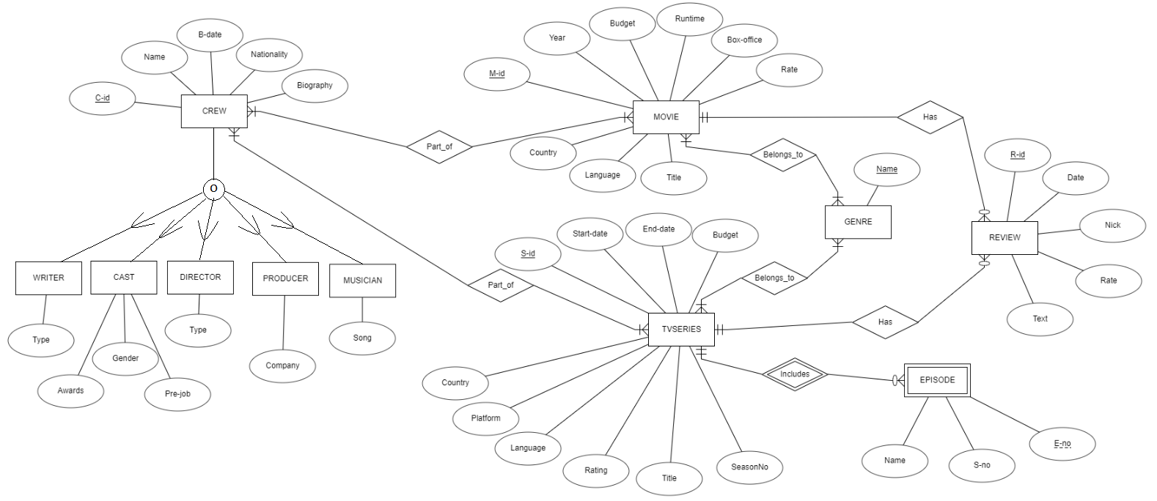
ER Diagram

